Slide 1
THE MATRIX
Ananya P
Blenson DSouza
Abhijith Mallya
Zainudain

Slide 2
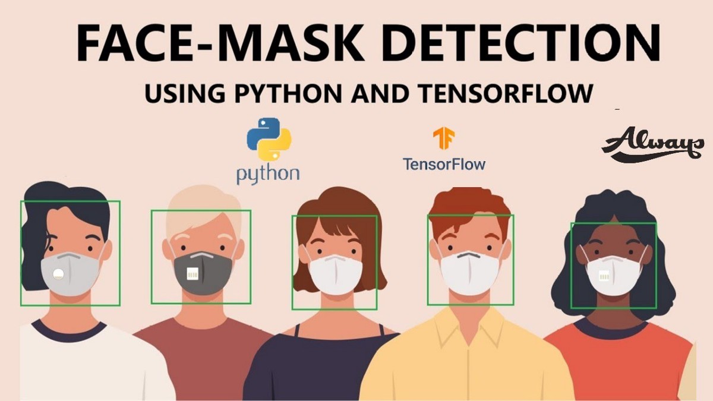

Slide 3
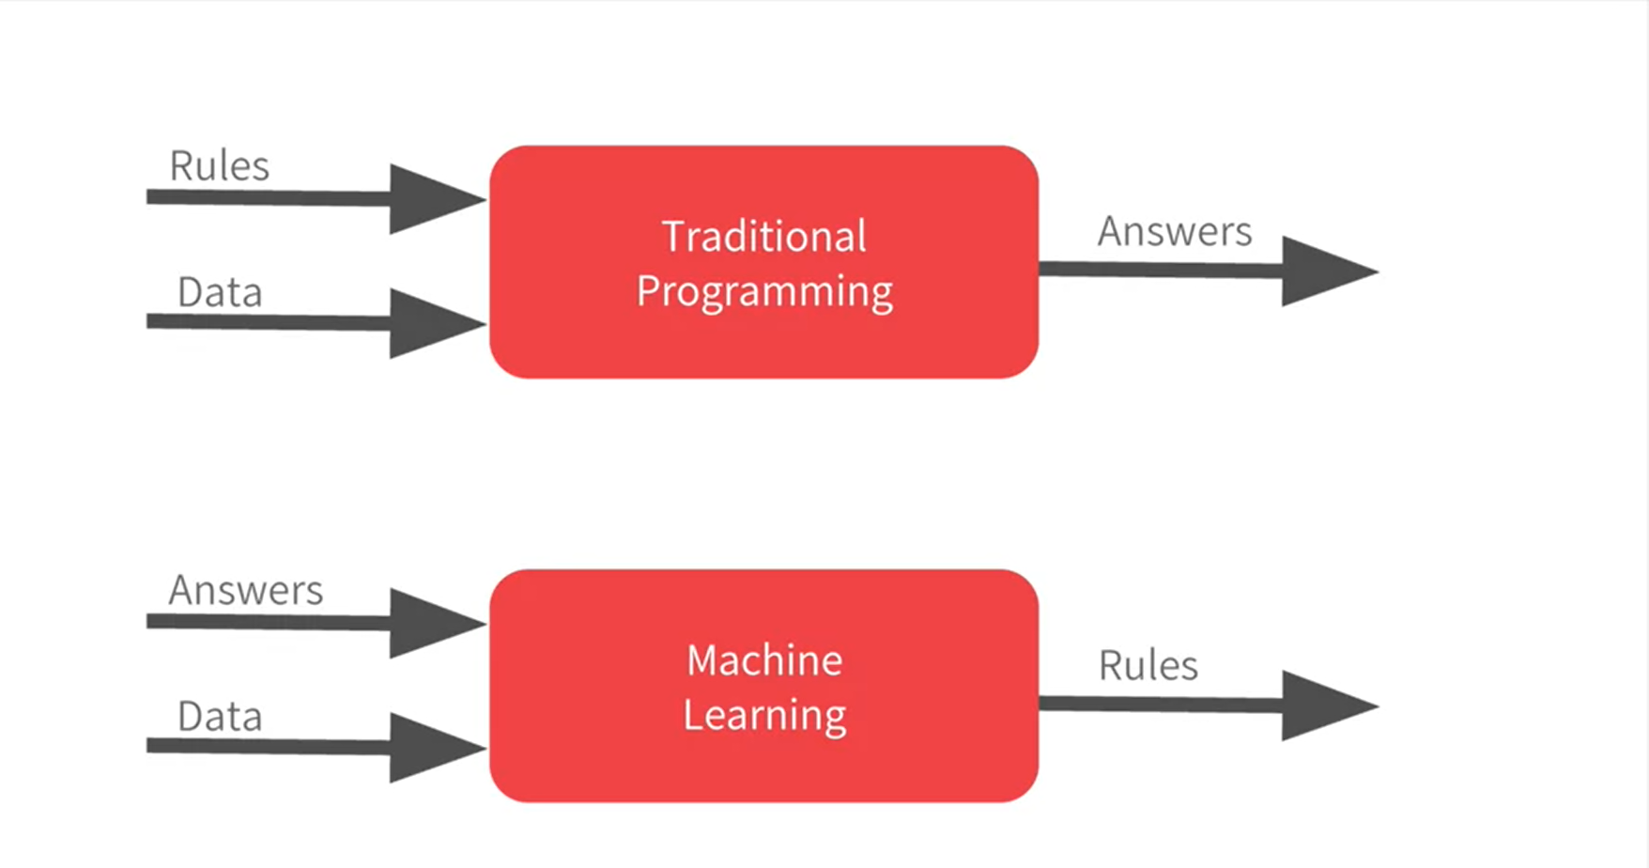

Slide 4
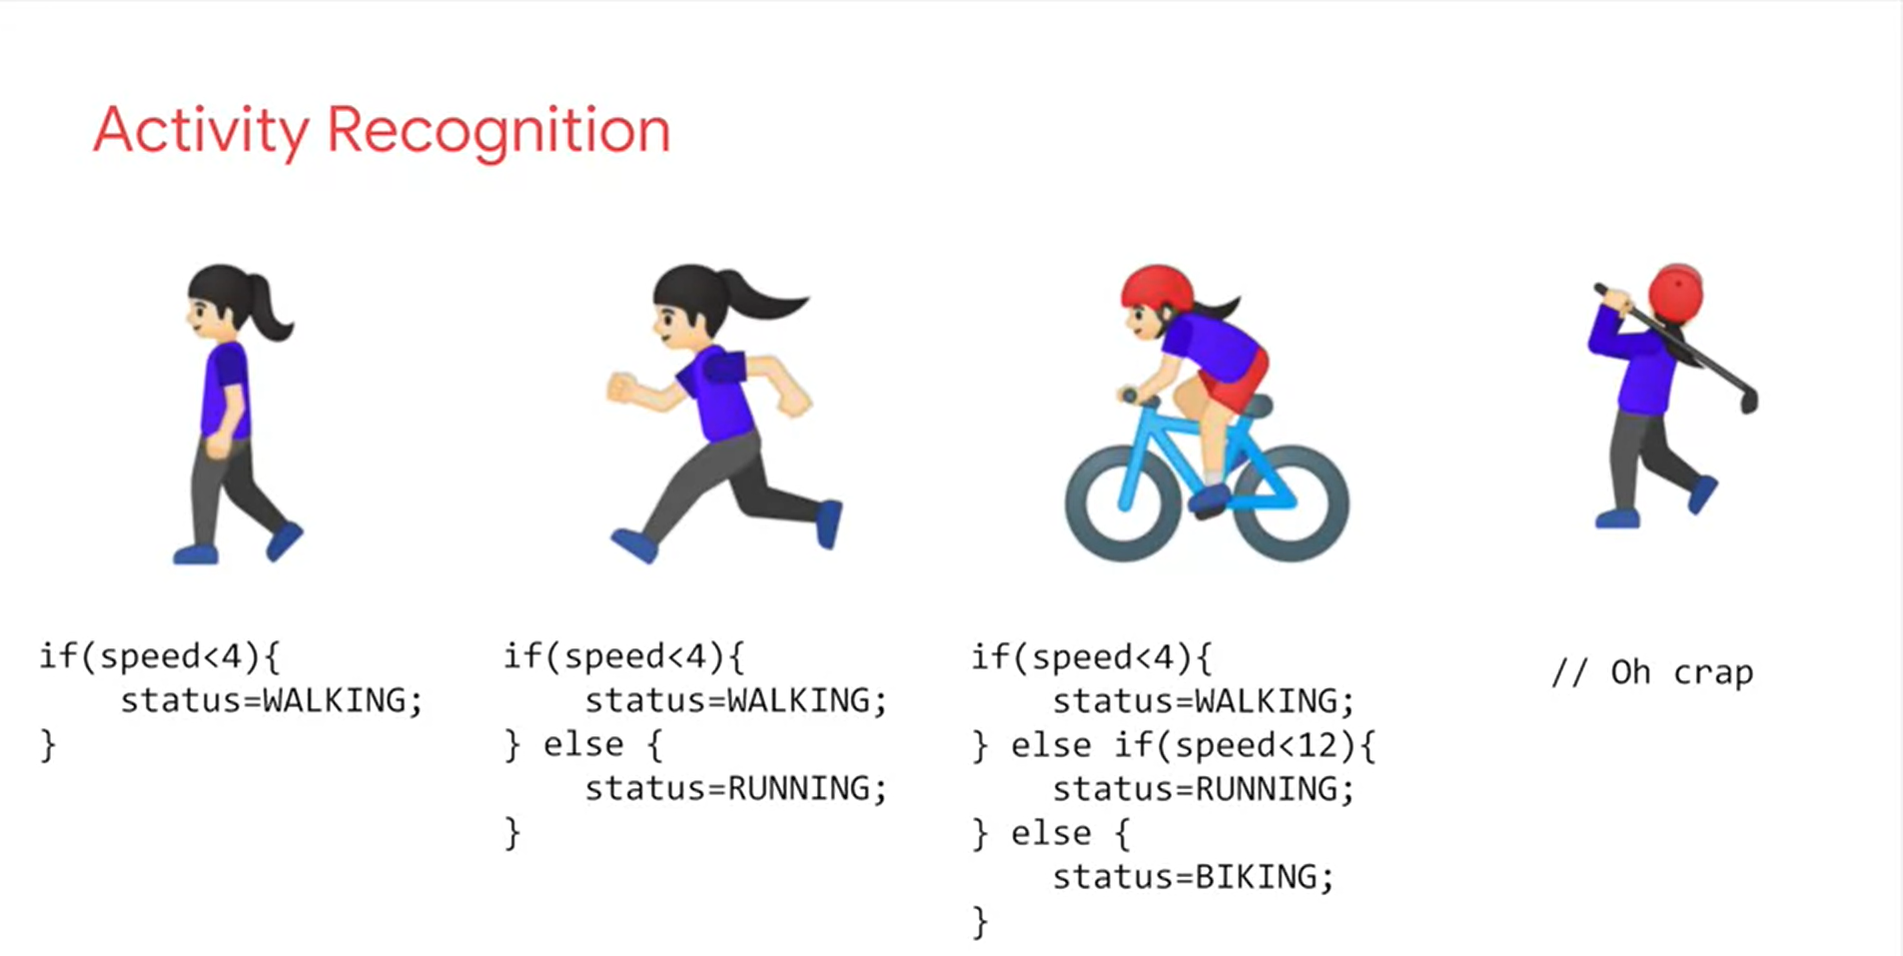

Slide 5
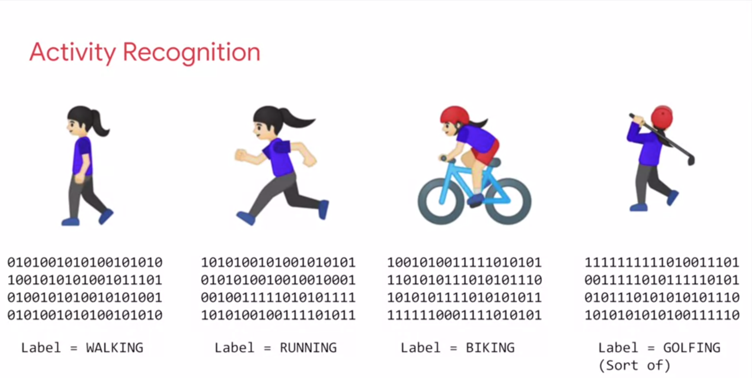

Slide 6
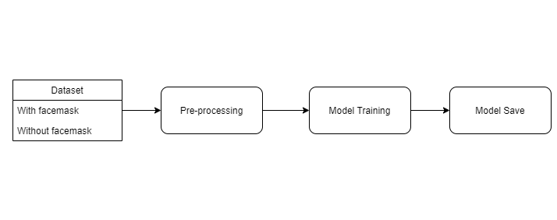

Slide 7
What is Deep Learing → Deep learning is part of a broader family of machine learning methods based on artificial neural networks with representation learning.
Examples for different libraries for deep learning → Tensorflow(by google) , pytorch(by Facebook's AI Research lab) , theano(), OpenCV(developed by intel) etc.
What is Neural Network → subset of machine learning and are at the heart of deep learning algorithms. Their name and structure are inspired by the human brain, mimicking the way that biological neurons signal to one another.

Slide 8
File and libraries used in our project
Tensorflow → end to end open source platform for machine learning. It provides flexible ecosystems of tools , libraries and community resources that lets programmers enable machine learning , easily build and deploy ML powered application.
Keras → Keras is an open-source software library that provides a Python interface for artificial neural networks. Keras acts as an interface for the TensorFlow library
Numpy → stands for Numerical python. Used for multidimentioal array objects and collection of arrays.
ONLY with ARRAYS DEEPLEARNING models work.
Matplotlib → is a comprehensive library for creating static, animated, and interactive visualizations in Python
OpenCV → taken from opensource → open source library used for computer vision , image analysis.

Slide 9
THANK YOU

